Slide 1
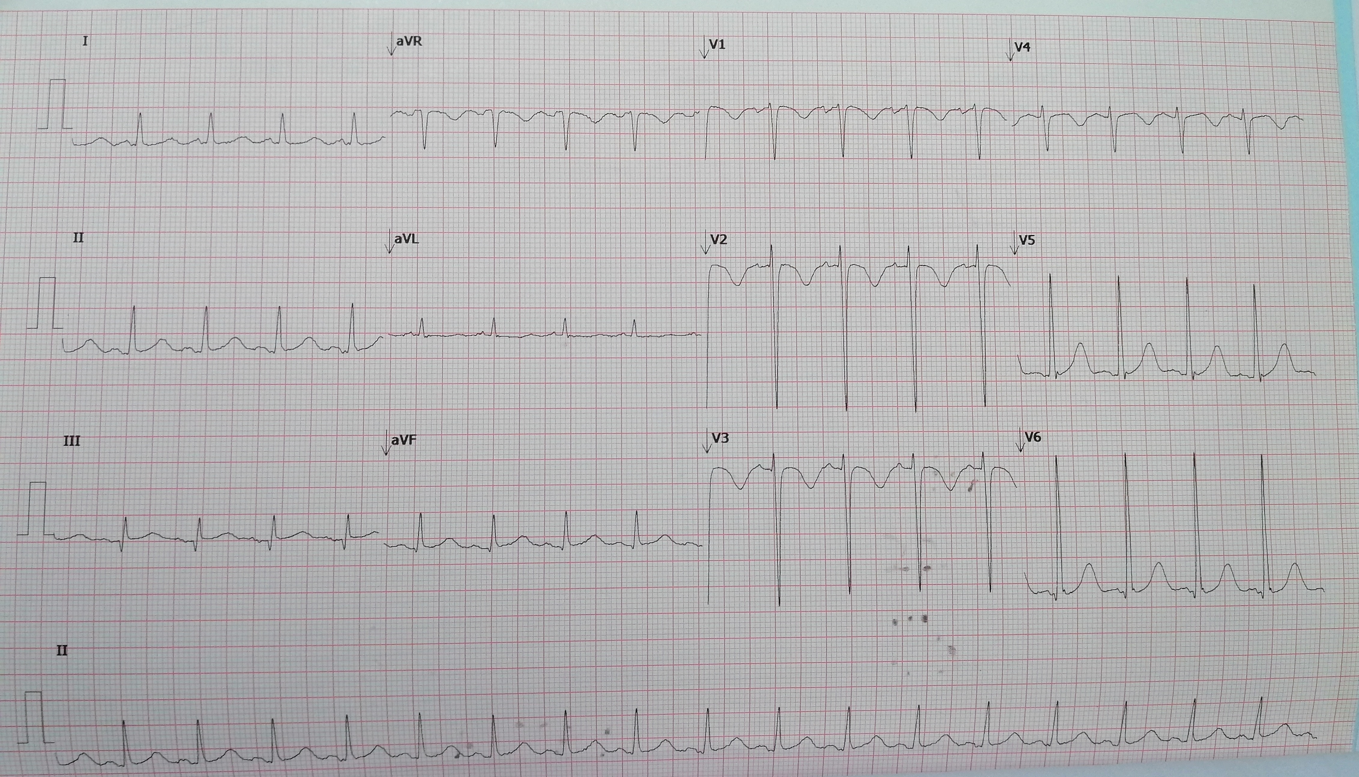
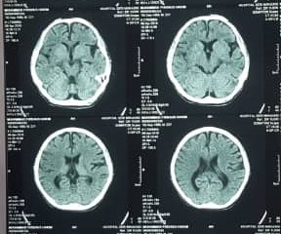
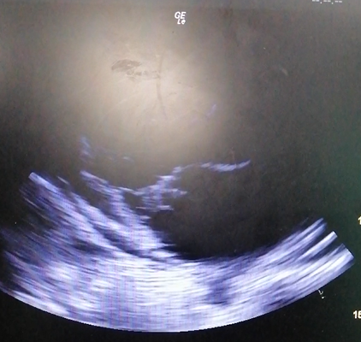
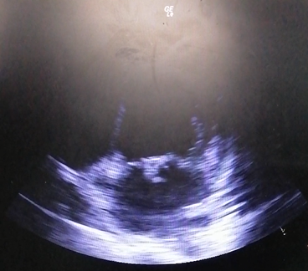
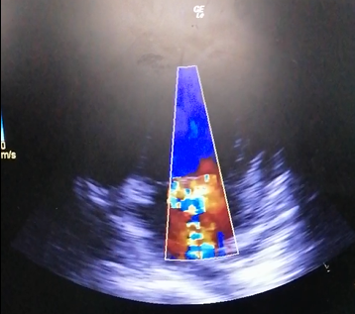
P O C U S
¹Muhammad Khidir, ¹M.Rishya
¹Emergency and Traumatology Department, Pusat Perubatan Universiti Malaya
Septic Cerebral Infarct Complicated by Methycillin-resistant Coagulase-negatvie Staphylococcus (MRCoNS) Endocarditis aided by Point-of-care Ultrasound
The diagnosis of infective endocarditis (IE) in emegency department can be challenging as it may manifest non-specific signs and symptoms or in worst case manifested as IE-related complications such as stroke. Neurological manifestation of IE was commonly due to embolization of cardiac valvular vegetations that occluded the cerebral arteries. The diagnosis of IE required fulfilling modified Duke Criteria that included positive blood cultures and echocardioprahic findings of typical IE such as valvular vegetation, peri-annular abscess, new onset valvular regurgitations or prosthetic valve dehiscence. Currently, the usage of point-of-care echocardioraphy in emergency department was rapidly expanding and can assist in immediate diagnosis and treatment of IE.
INTRODUCTION
A 22-year-old Malay gentleman was sent to our emergency department by ambulance with a chief complaint of acute left sided weakness associated with slurring of speech and fever for one day. He had underlying end-stage renal disease as a result from traumatic ureteric stricture that required him lifelong dialysis. Currently, he was underwent haemodialysis via right internal jugular catheter while waiting for arterio-venous fistula operation.
On arrival, his vital signs showed a blood pressure of 134/92 mm Hg, pulse rate of 107 beats/min, respiratory rate of 24 breaths/min, body temperature of 39°C, and oxygen saturation of 95 % under 3L/min oxygen supplementation. Physical examinations revealed a grade 5/6 holosystolic murmur loudest at the apex that radiated to axilla with palpable thrills. Neurologic examinations demonstrated grade 0/5 of muscle power over both left upper limb and lower limb with a positive babinski sign, whereas tendon reflexes were brisk over left knee and ankle. Cranial nerve examination showed left homonymous hemianopia on bilateral visual fields with left upper motor neuron facial nerve palsy.
His laboratory investigations demonstrated white cell counts of 18.2 x 103 /uL, haemoglobin of 6.5 g/dL, blood urea nitrogen (BUN) of 24.5 mmol/L and creatinine level was 1253 mmol/L. Initial electrocardiogram showed sinus rhythm with first degree AV nodal block and marked T wave inversion over anterior leads with left ventricular hypertrophy by using the Sokolow-Lyon criteria [Figure 1]. Computed tomography of the brain demonstrated hypodensity over right lentiform nucleus with minimal effacement of right sylvian fissure suggestive of acute infarct [Figure 2].
CASE PRESENTATION
DISCUSSION
Cerebral embolism complicated up to 40 % of IE-related complications and was due to embolization of valvular vegetation that occluded cerebral arteries.
Central nervous system complications can be categorized into embolic brain infarction, transient ischaemic attacks, cerebral haemorrhage, meningitis, brain abscess, toxic encephalopathy and headache.
Mortality rate was significantly higher in patients who developed neurological complications compared to patients without neurological manifestations (24 % versus 10 %).
S. aureus was evident in 29 % of patients complicated with neurological complications and there was no other microbes showed significantly associated with neurological complications.
The impact of diagnosis delays on clinical outcomes of IE patients, whereby late diagnosis of >4 days was associated with significant embolic phenomena as compared to early diagnosis of < 4 days (40 % versus 14 %).
The higher proportion of patients required valve surgery in patients who underwent late echocardiography (73 % vs 56 %).
Transthoracic echocardiography (TTE) was cheap, rapid, non-invasive and readily accessible in most acute care settings compared to transesophageal echocardiography (TOE).
About 59 % of IE cases can be detected initially by using TTE.
The European Society of Cardiology (ESC) guidelines of IE recommended TTE should be performed first for suspected IE cases, followed by TEE for cases with uncertainty or unconfirmed results but with a high clinical suspicion.
 | Sensitivity | Specificity
Transthoracic Echo. | 65% | 96%
Transesophageal Echo. | 95% | 95%
Table 1: Comparison between transthoracic echo versus transesophageal echo for detecting IE
Figure 1: ECG demonstrates T wave inversion of anterior leads and left ventricular hypertrophy.
Figure 2: Computed tomography of the brain demonstrates hypodensity over right lentiform nucleus.
Bedside echocardiography revealed hypokinesia over anterior, septal and basal walls with severe mitral regurgitation and vegetation noted over anterior mitral valve leaflet measuring 1.7 to 2.0 cm ² [Figure 3,4,5]. His ejection fraction was 44 % and no intramural thrombus.
CONCLUSION
Clinician should be aware of varied presentations of infective endocarditis, and reliance on echocardiographic findings and positive cultures as major criteria, making the diagnosis in emergency department extremely difficult. However, the accessibility of focused echocardiography can expedite the diagnosis and management of IE by emergency physician.
1) Brit Long and Alex Koyfman. Infectious endocarditis: An update for emergency clinicians. Ajem 2018. Vol 36:9.
2) Maija Heiro, Jukka Nikoskelainen, Erik Engblom et al. Neurologic Manifestations of Infective Endocarditis A 17-Year Experience in a Teaching Hospital in Finland. Arch Intern Med 2000. Vol 160.
3) Leonardo Schirone , Alessandra Iaccarino, Wael Saade et al. Cerebrovascular Complications and Infective Endocarditis: Impact of Available Evidence on Clinical Outcome. BioMed Research International. Volume 2018.
4) Enrico Cecchi, Fabio Chirillo, Pompilio Faggiano et al. The Diagnostic Utility of Transthoracic Echocardiography for the Diagnosis of Infective Endocarditis in the Real World of the Italian Registry on Infective Endocarditis. Echocardiography 2013.
5) Mügge A, Daniel WG, Frank G et al. Echocardiography in infective endocarditis: reassessment of prognostic implications of vegetation size determined by the transthoracic and the transesophageal approach. J Am Coll Cardiol 1989.
Figure 3
Figure 4
Figure 5
REFERENCES
Valvular vegetation seen in parasternal long axis view [Figure 3] and apical four chamber view [Figure 4] with severe mitral regurgitation on colour flow mode [Figure 5]
He was diagnosed with acute total anterior circulation infarct with possible etiology of embolization originated from valvular vegetations. Two of his blood cultures showed coagulase-negative Staphylococcus which were resistant to beta-lactamase groups, and only sensitive to Vancomycin. He was put on six weeks course of intravenous vancomycin. Prior to discharge, he regained neurological function in which, his muscle power increased from 0/5 to 4/5 and his speech showed improvement. He was referred to cardiologist outpatient for subsequent management of his IE.

